Slide 1
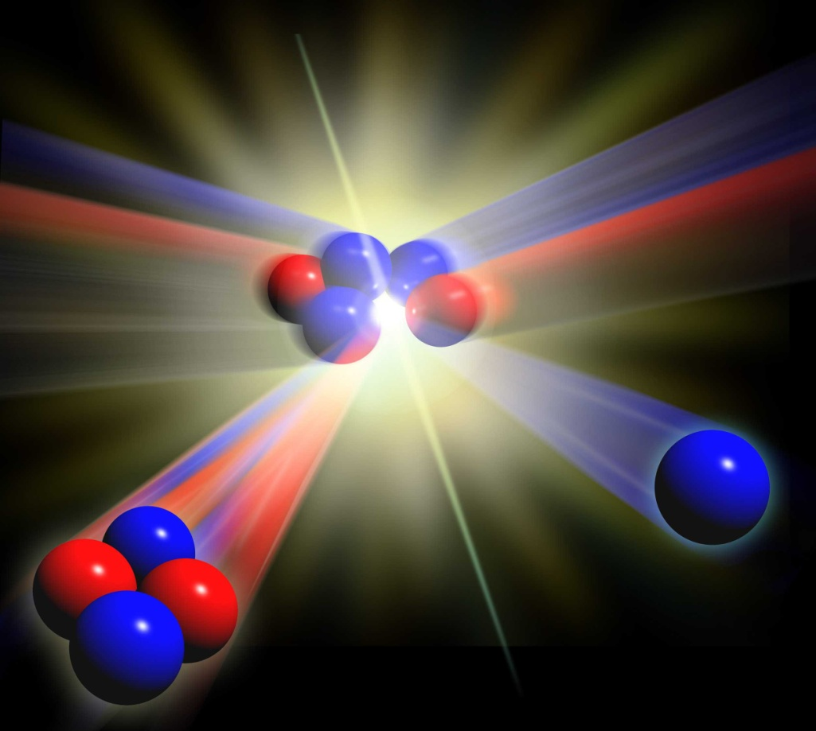
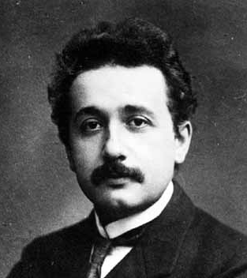
Fusion may be a 21st Century solution
Fusion occurs when two cores, or nuclei, of small atoms are forced together, producing a bigger nucleus
The mass of the nuclei produced is less than the mass of the original two nuclei
The mass deficit is changed into energy
We can calculate the energy released using Einstein’s famous equation:
E=mc²

Slide 2
Fusion may be a 21st Century solution
The easiest route to commercial power will be to fuse →
Deuterium
and
tritium
nuclei producing a
helium
nucleus and a
neutron
Deuterium and tritium are both forms, or isotopes, of hydrogen
10 g of deuterium and 15g of tritium would supply the lifetime energy needs of an average person in EU
1kg of this fuel would supply the same amount of energy as 10,000,000 kg of coal
deuterium
tritium
neutron
helium

Slide 3
Advantages of Fusion Power
Fusion has little or no environmental impact - no Greenhouse gas emissions
Fusion does not produce any ‘long-lived’ radioactive waste
There is no risk of critical safety events like Fukushima
The fuels are abundant and there is no geographical localisation.
Deuterium is freely available in seawater. Tritium can be derived from lithium, the 25th most abundant element in the Earth’s crust

Slide 4
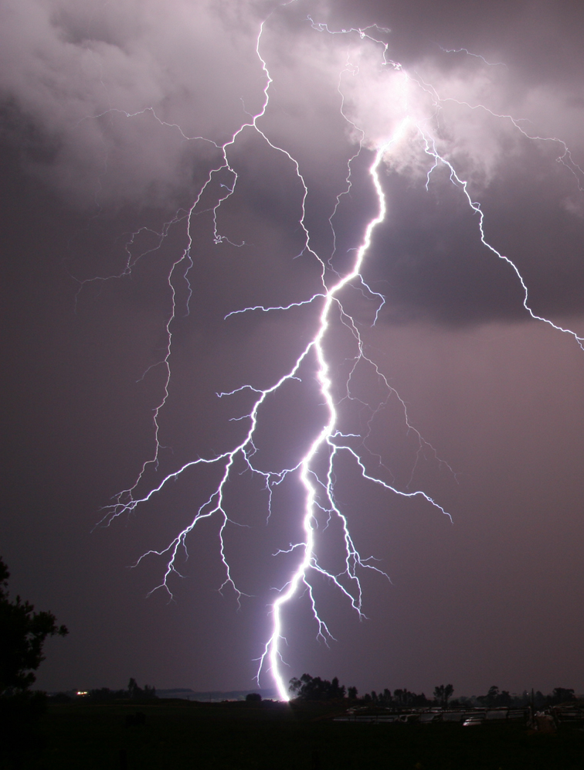
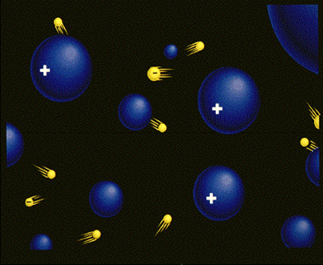
Plasmas are key to fusion
What is a plasma?
➢ Plasma is the fourth state of matter (after solid, liquid and gas)
When a gas is super-hot, the atoms split into positively charged nuclei and negative electrons
The gas conducts electricity and its behavour is dominated by electrical effects
The charged particles have a lot of energy but rarely collide
The Sun is one example of a plasma, lightening is another ........

Slide 5
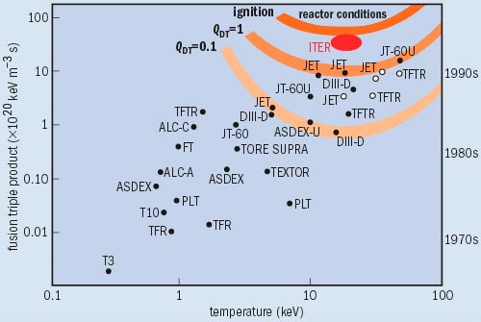
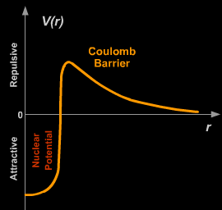
Fusion plasmas
For a plasma of deutrium and tritium to become a self-sustaining fusion plasma, three things are necessary:
Very high temperature
T
High density
n
D and T nuclei are both positively charged and thus repel each other
The closer they get, the stronger the repulsion – the “Coulomb barrier”
If they do get very close, an attractive force – the nuclear force - takes over and fusion happens
To cross the Coulomb barrier takes lots of energy ⇒ very high temperatures
τ_{E}
High energy confinement
more nuclei in a given volume
more collisions
more fusion reactions
Energy released from the fusion reactions must stay in the plasma long enough to maintain the high temperature
The Lawson Critereon
nTτ_{E} > 3x10²¹m⁻³keVs

Slide 6
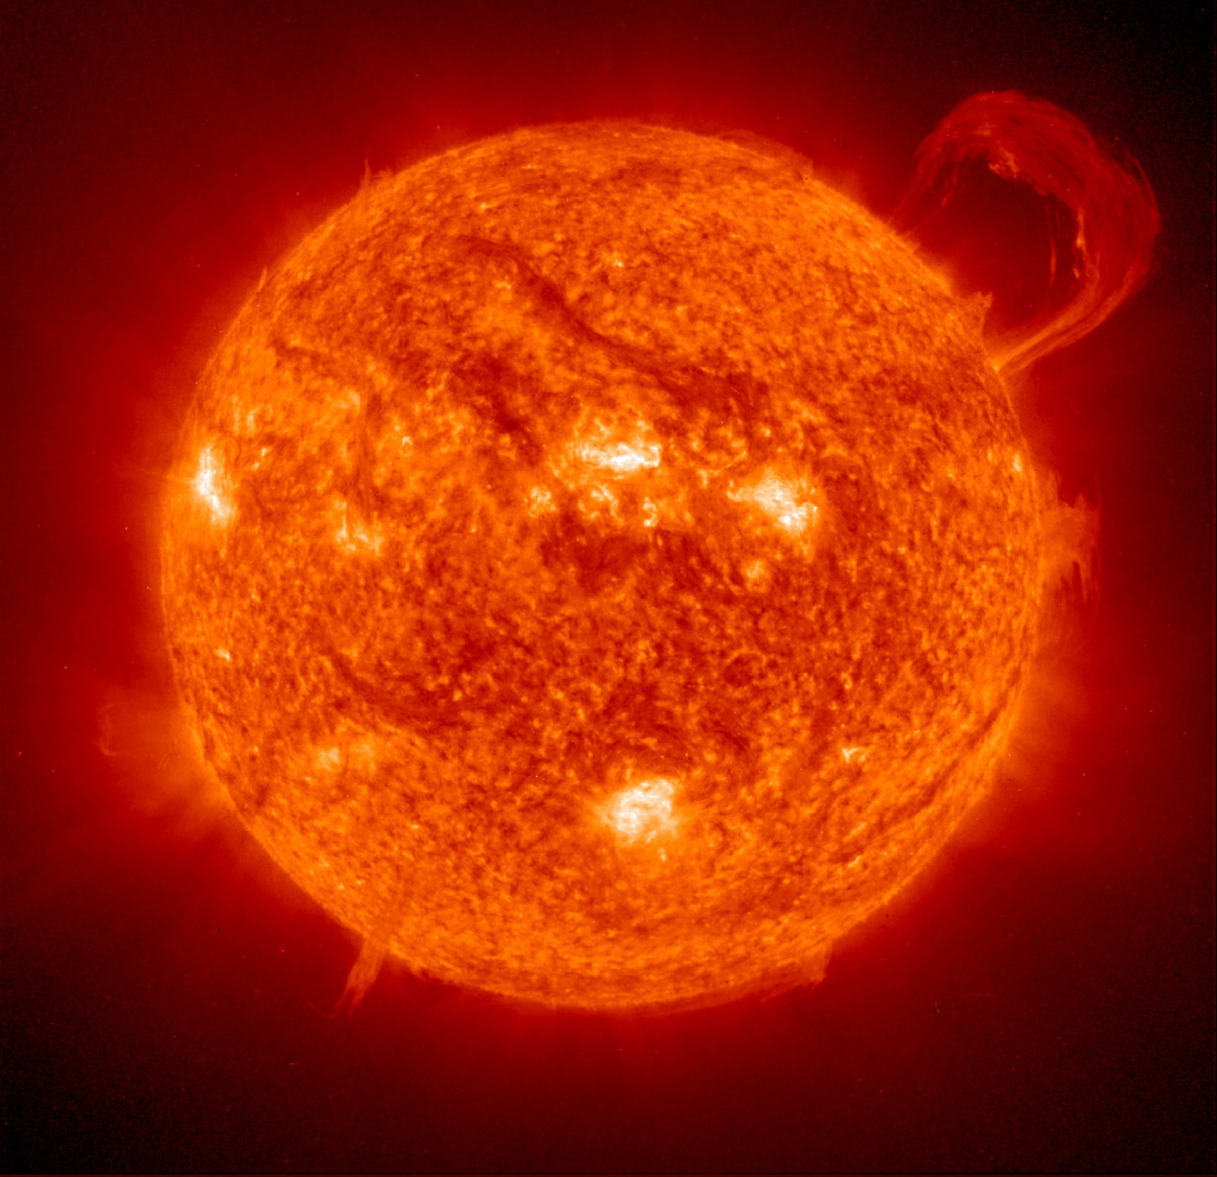
Confining a plasma
The force of GRAVITY holds the fusion plasma together in stars
Fusion plasmas made on Earth are too small to be confined by gravity, so other methods are used:
Inertial confinement
Magnetic confinement
Picture courtesy of NASA/ESA

Slide 7
Magnetic Confinement
Charged particles in a vessel move rapidly to the walls and are lost
However, when a magnetic field is added, the particles are forced to gyrate in the direction of the field. If the field is parallel to the walls, the particles are confined
Direction of magnetic field

Slide 8
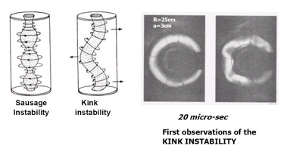
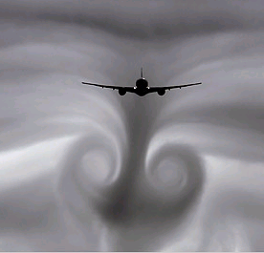
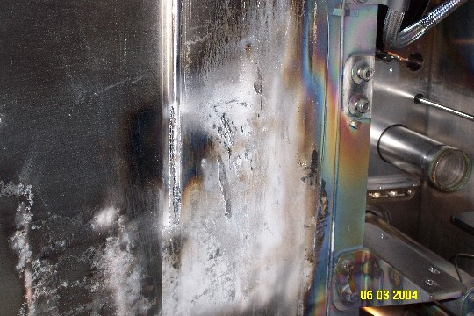
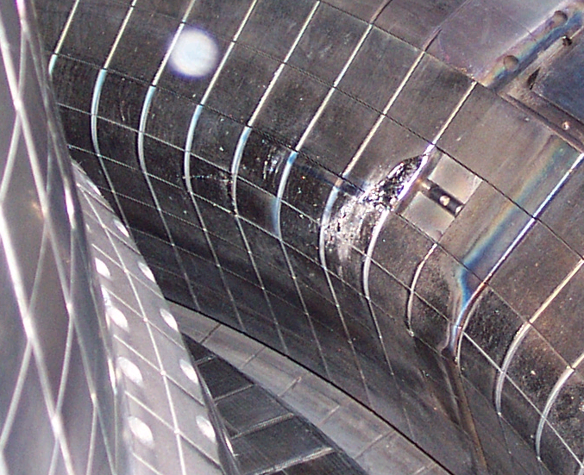
Challenges of magnetic confinement
1) Instabilities - difficult to confine a high density and temperature plasma with low magnetic fields
2) Turbulence - allows particles and energy to cross the magnetic field, limiting the confinement time for a given sized device
3) Power loading - high volume to surface area ratio means power loading on surfaces is high
4) Neutron activation - materials must withstand high neutron fluxes
‘smooth’ flows break up into erratic, swirling motions – this is turbulance
Pictures courtesty of MIT/C-MOD

Slide 9
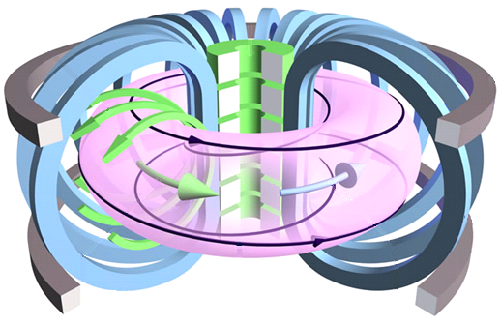
The tokamak
Toroidalnaya Kamera i Magnitnaya Katushka
(Toroidal Chamber and Magnetic Coil)
Poloidal magnetic field
Central solenoid
Toroidal magnetic field
1950 → Sakharov & Tamm
1951 → Kurchatov
1968 →The Russians achieved keV
Poloidal field coils
Helical magnetic field
Toroidal plasma current
Toroidal field coils

Slide 10
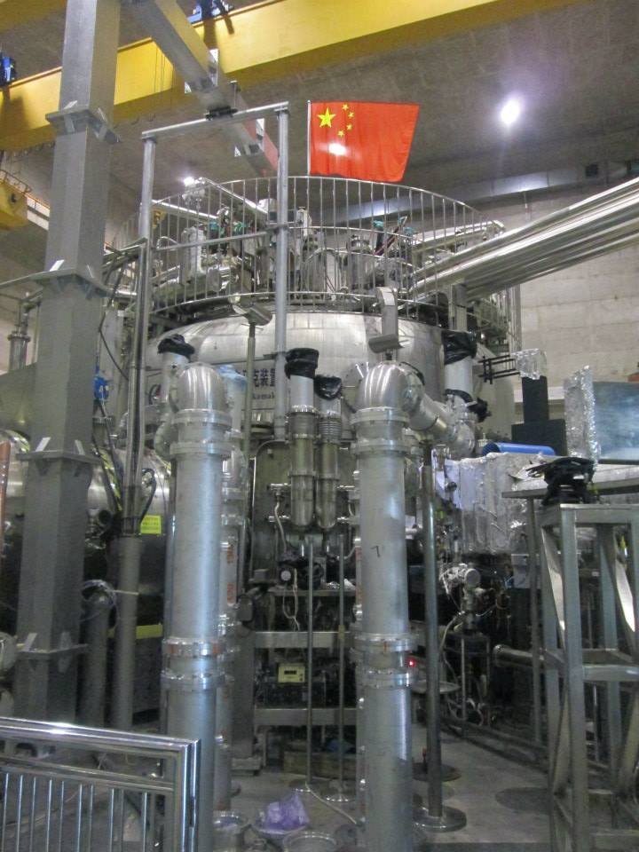
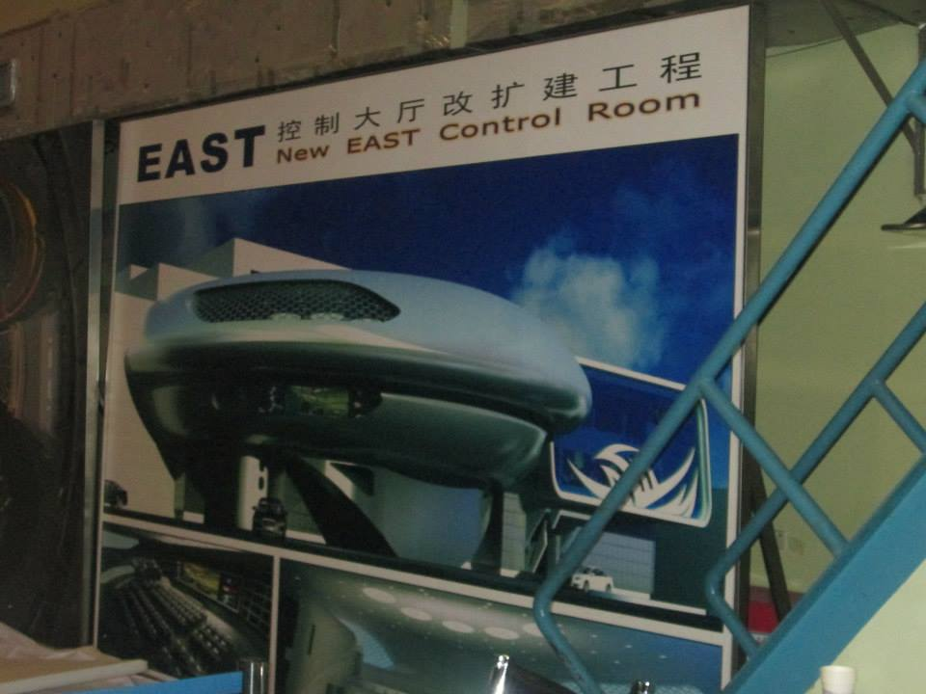
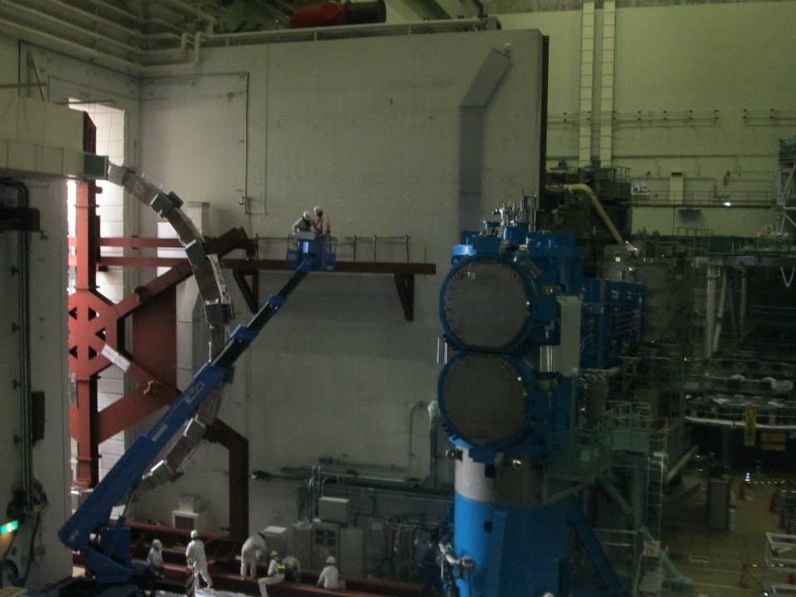
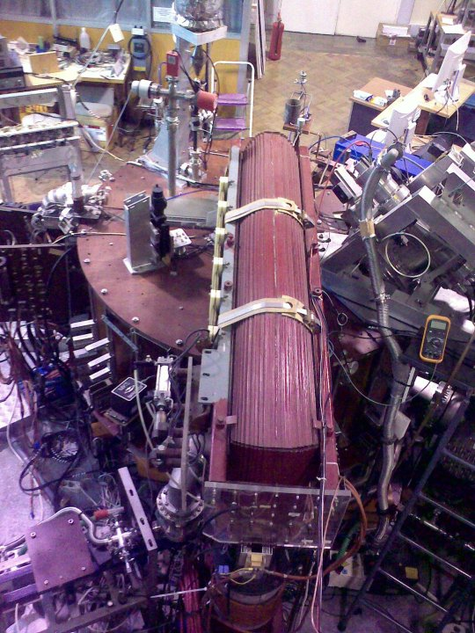
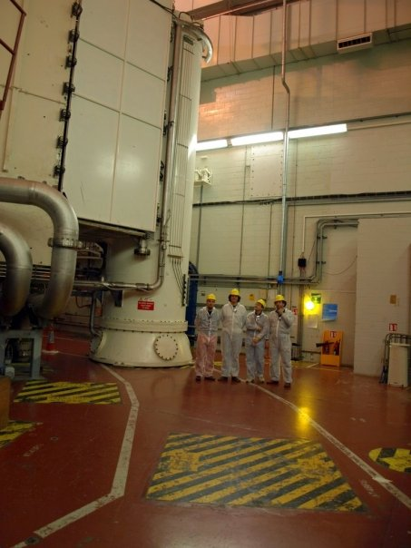
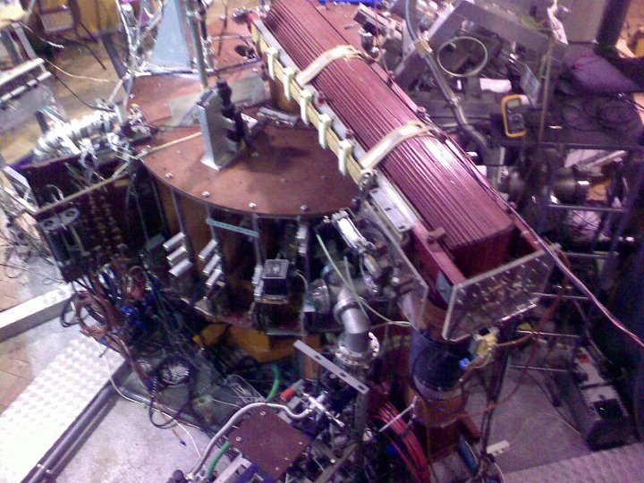
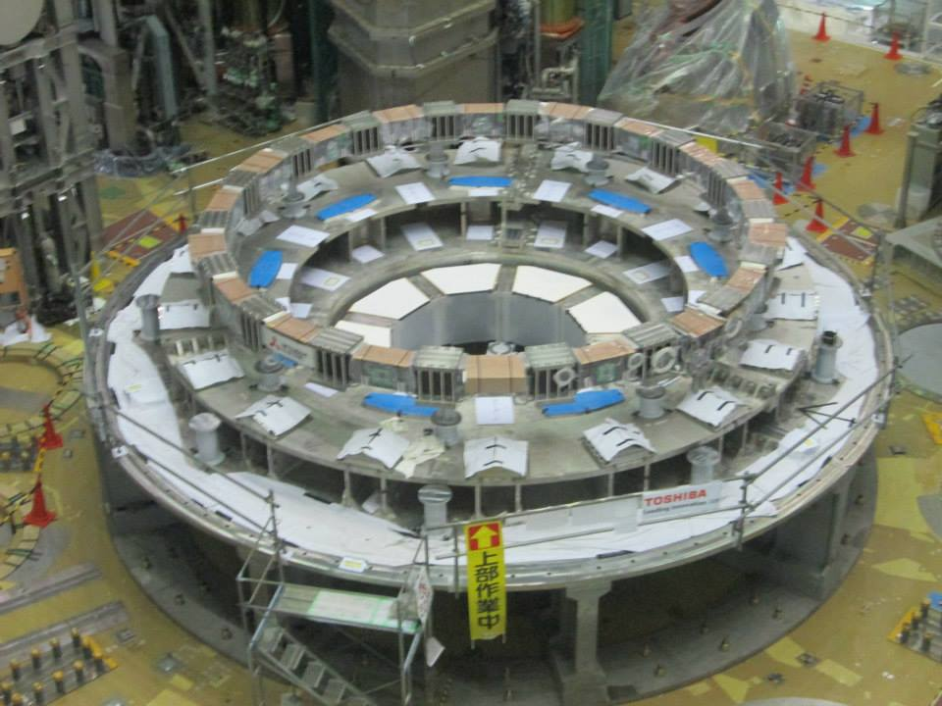
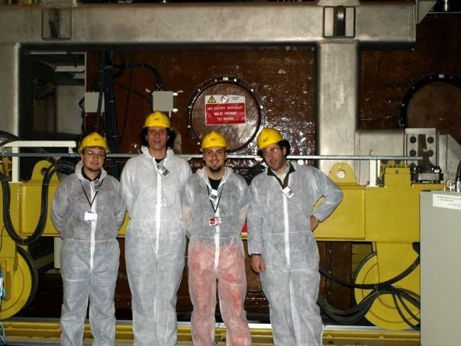
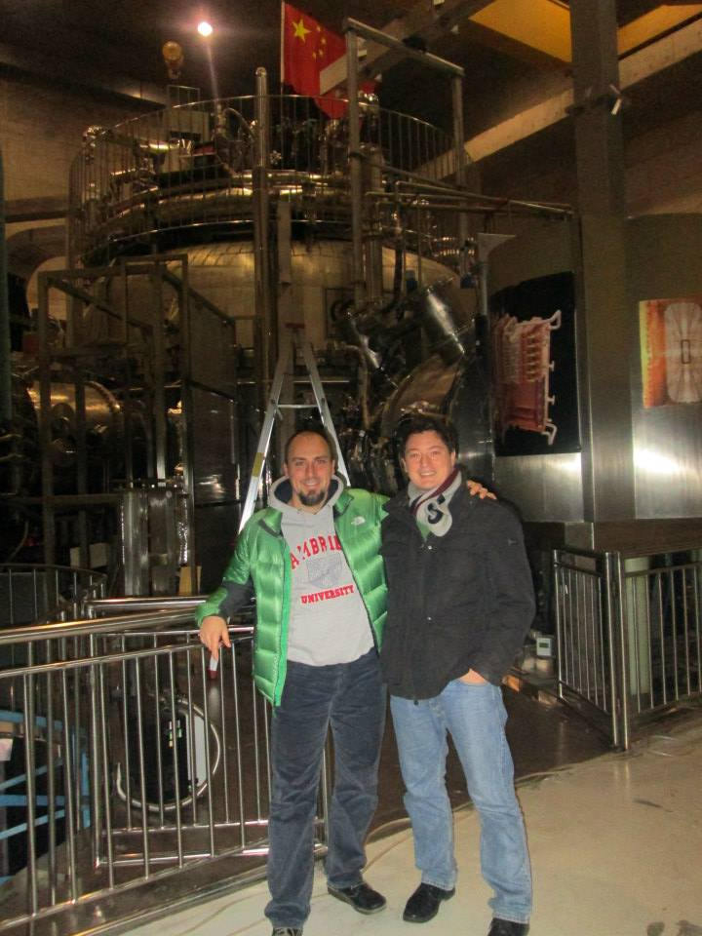
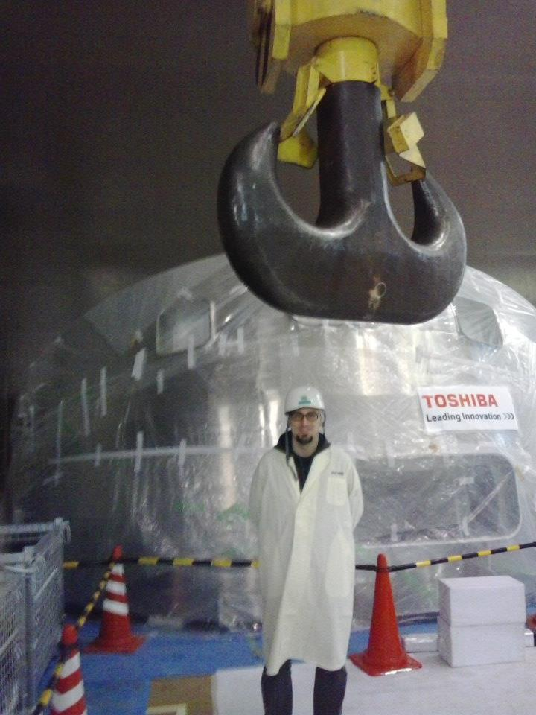
Tokamaks around the world
https://alltheworldstokamaks.wordpress.com

Slide 11
The JET tokamak

Slide 12
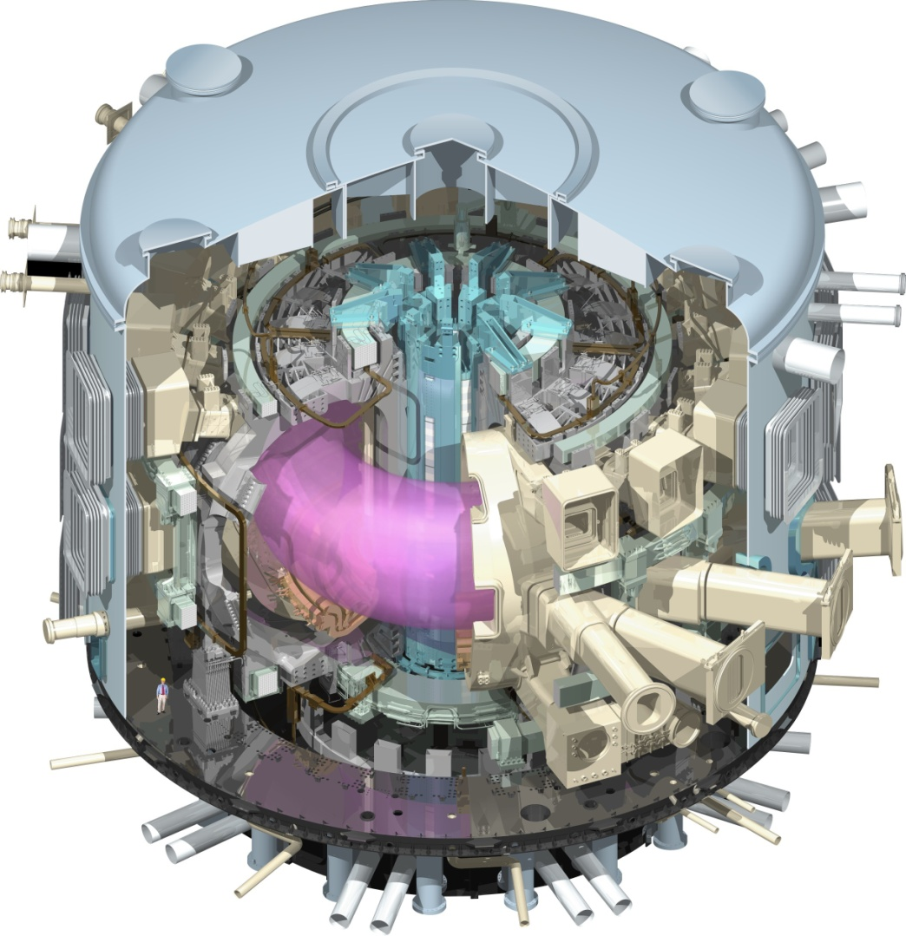
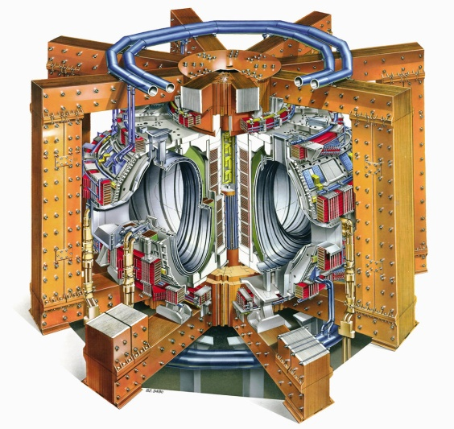
ITER - the Next Step
Produce significant amounts of fusion power (at least ten times the power required to heat the plasma up).
Plasma duration ~10 minutes
Aim at demonstrating steady-state operation.
Develop fusion reactor relevant technologies

Slide 13
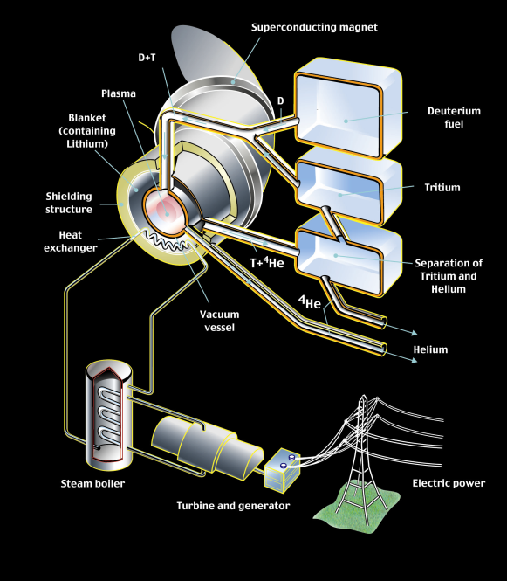
The future of fusion power
Fusion Power
Typical Plasma duration
When?
Gain
JET
1997 16MW 10 seconds 0.65
ITER
2020-2040 500-700MW 10 minutes 10
Power
Plant
2050? 1.5-2GW days/cont. 30

Slide 14
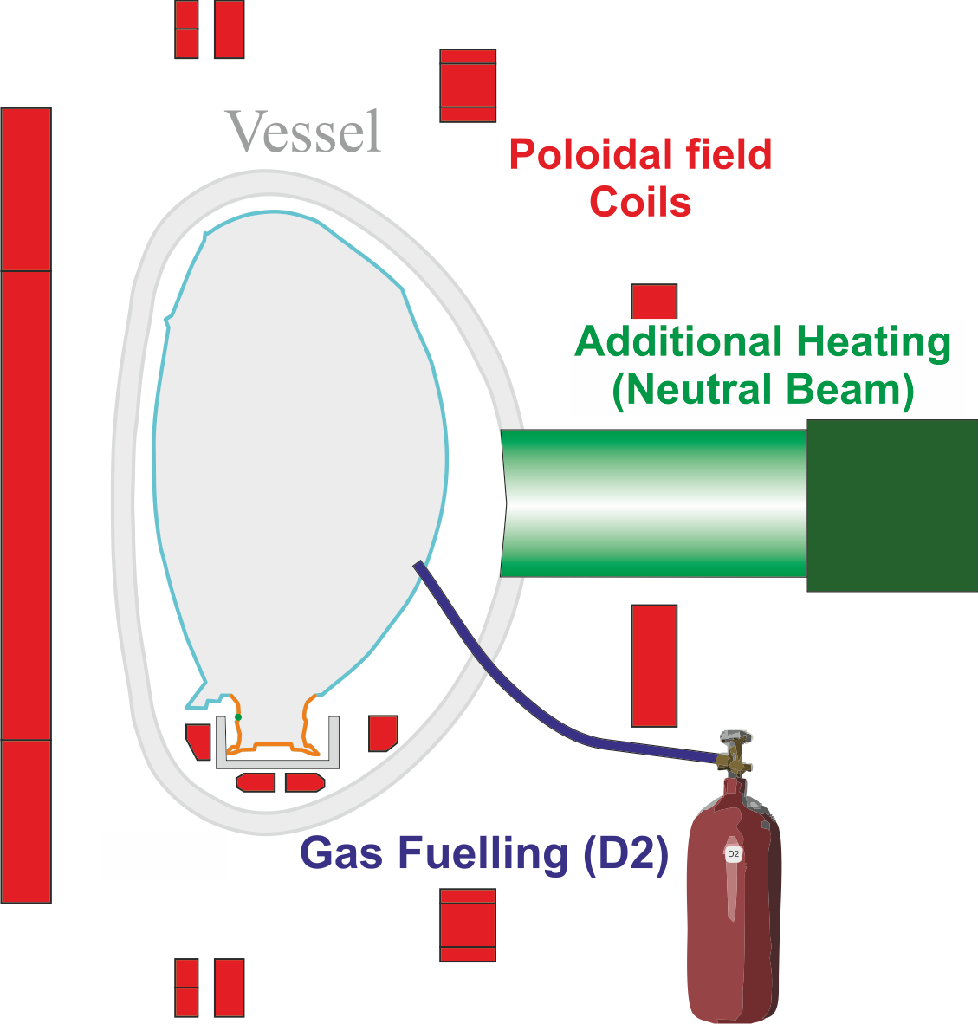
The plasma system
The Central solenoid creates an electric field. GAS is added and ionised → plasma.
During plasma growth PF coils control plasma radial position.
Other PF coils shape the plasma into diverted shape
Additioal heating heats the plasma
The conditions for fusion are (hopefully) reached!
14

