Slide 1
I&C integration of EU diagnostics in the ITER tokamak
Neto on behalf of the F4E-CODAC Team, May 2015
Fusion introduction slides: courtesy of G. Counsell (F4E)
Notes:
Use preferably the corporate colours
Use the Calibri or Arial fonts
Don't centre text. All body text should be aligned left.
Don't enlarge pictures beyond their actual size/resolution
Make sure you understand how bulleted lists work.

Slide 2
What will I talk about?
Quick overview of some of the diagnostic activities that are being done in the F4E CODAC I&C group
Brief introduction
Fusion
Tokamaks
ITER
Diagnostics
CODAC
The magnetics diagnostic
I&C integration example
Overview of the activities
Requirements and design
Software
Real-time (MARTe)
Scientific
Hardware
Prototyping

Slide 3
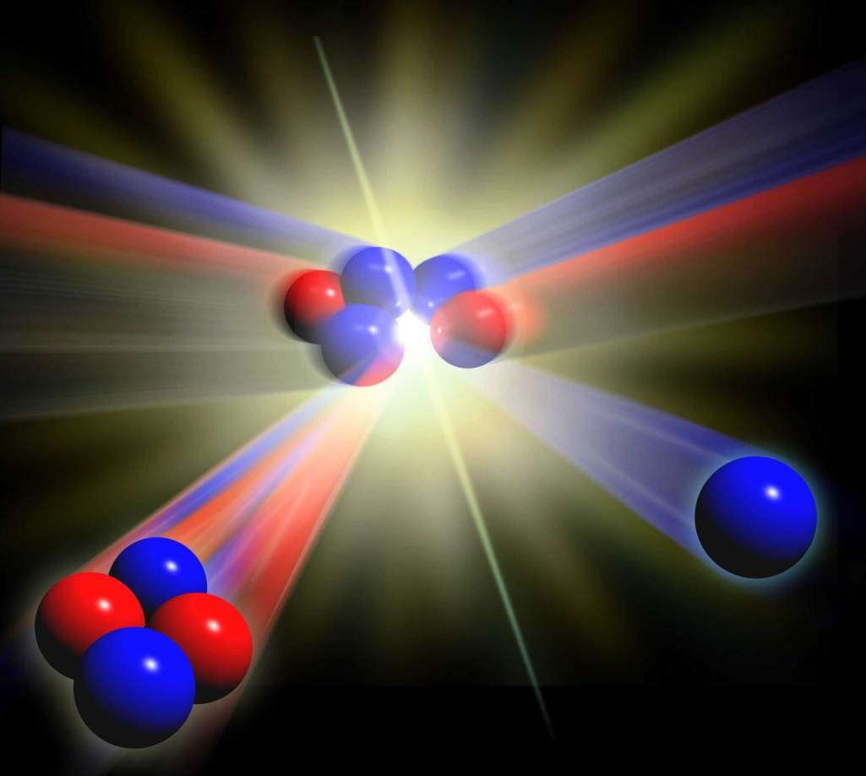
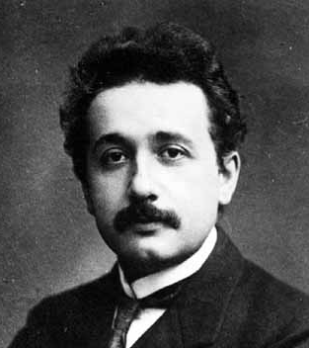
Fusion may by a 21st Century solution
Fusion occurs when two cores, or nuclei, of small atoms are forced together, producing a bigger nucleus
The mass of the nuclei produced is greater than the mass of the original two nuclei
The extra mass is changed into energy
We can calculate the energy released using Einstein’s famous equation:
E=mc²

Slide 4
Fusion may by a 21st Century solution
The easiest route to commercial power will be to fuse →
Deuterium
and
tritium
nuclei producing a
helium
nucleus and a
neutron
Deuterium and tritium are both forms, or isotopes, of hydrogen
10 g of deuterium and 15g of tritium would supply the lifetime energy needs of an average person in EU
1kg of this fuel would supply the same amount of energy as 10,000,000 kg of coal
deuterium
tritium
neutron
helium

Slide 5

Advantages of Fusion Power
Fusion has little or no environmental impact - no Greenhouse gas emissions
Fusion does not produce any ‘long-lived’ radioactive waste
There is no risk of critical safety events like Fukushima
The fuels are abundant and there is no geographical localisation.
Deuterium is freely available in seawater. Tritium can be derived from lithium, the 25th most abundant element in the Earth’s crust

Slide 6

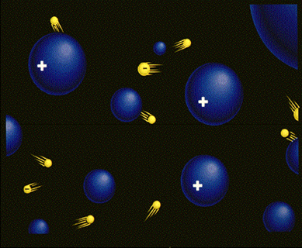
Plasmas are key to fusion
What is a plasma?
➢ Plasma is the fourth state of matter (after solid, liquid and gas)
When a gas is super-hot, the atoms split into positively charged nuclei and negative electrons
The gas conducts electricity and its behavour is dominated by electrical effects
The charged particles have a lot of energy but rarely collide
The Sun is one example of a plasma, lightening is another ........

Slide 7
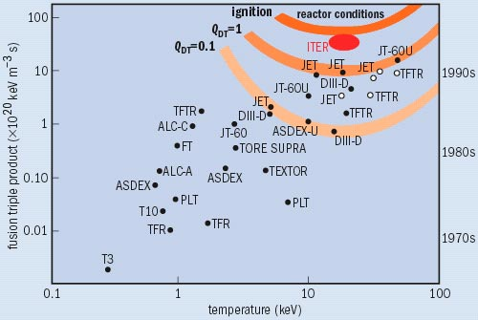
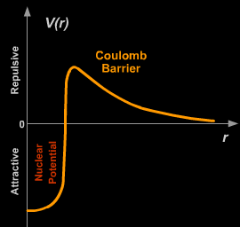
Fusion plasmas
For a plasma of deutrium and tritium to become a self-sustaining fusion plasma, three things are necessary:
Very high temperature
T
High density
n
D and T nuclei are both positively charged and thus repel each other
The closer they get, the stronger the repulsion – the “Coulomb barrier”
If they do get very close, an attractive force – the nuclear force - takes over and fusion happens
To cross the Coulomb barrier takes lots of energy ⇒ very high temperatures
τ_{E}
High energy confinement
more nuclei in a given volume
more collisions
more fusion reactions
Energy released from the fusion reactions must stay in the plasma long enough to maintain the high temperature
The Lawson Critereon
nTτ_{E} > 3x10²¹m⁻³keVs

Slide 8
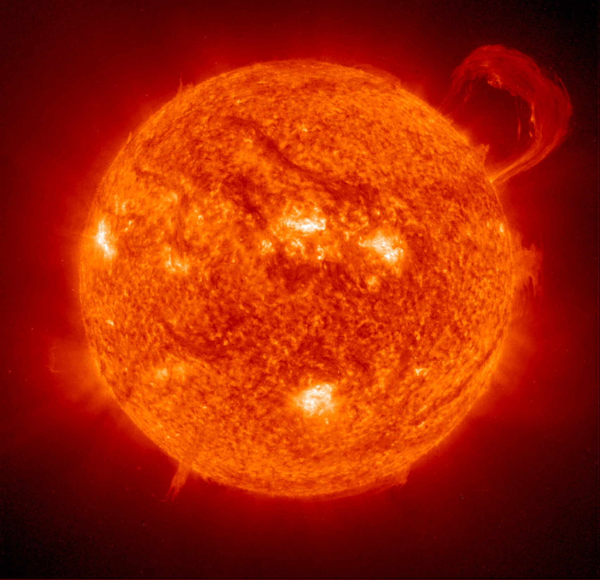

Confining a plasma
The force of GRAVITY holds the fusion plasma together in stars
Fusion plasmas made on Earth are too small to be confined by gravity, so other methods are used:
Inertial confinement
Magnetic confinement
Picture courtesy of NASA/ESA

Slide 9
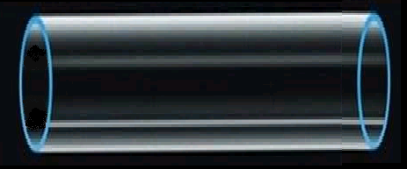
Magnetic Confinement
Charged particles in a vessel move rapidly to the walls and are lost
However, when a magnetic field is added, the particles are forced to gyrate in the direction of the field. If the field is parallel to the walls, the particles are confined
Direction of magnetic field

Slide 10
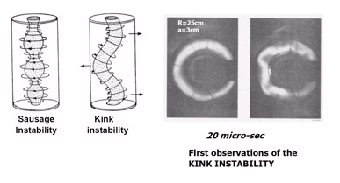

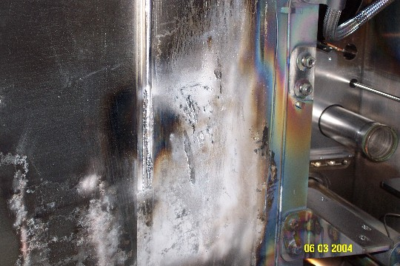
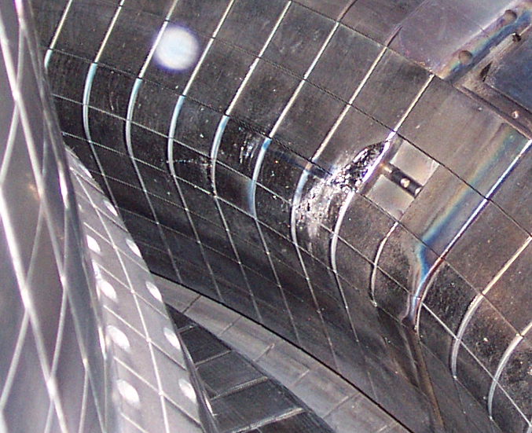
Challenges of magnetic confinement
1) Instabilities - difficult to confine a high density and temperature plasma with low magnetic fields
2) Turbulence - allows particles and energy to cross the magnetic field, limiting the confinement time for a given sized device
3) Power loading - high volume to surface area ratio means power loading on surfaces is high
4) Neutron activation - materials must withstand high neutron fluxes
‘smooth’ flows break up into erratic, swirling motions – this is turbulance
Pictures courtesty of MIT/C-MOD

Slide 11
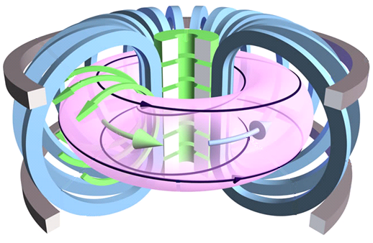
The tokamak
Toroidalnaya Kamera i Magnitnaya Katushka
(Toroidal Chamber and Magnetic Coil)
Poloidal magnetic field
Central solenoid
Toroidal magnetic field
Poloidal field coils
Helical magnetic field
Toroidal plasma current
Toroidal field coils

Slide 12


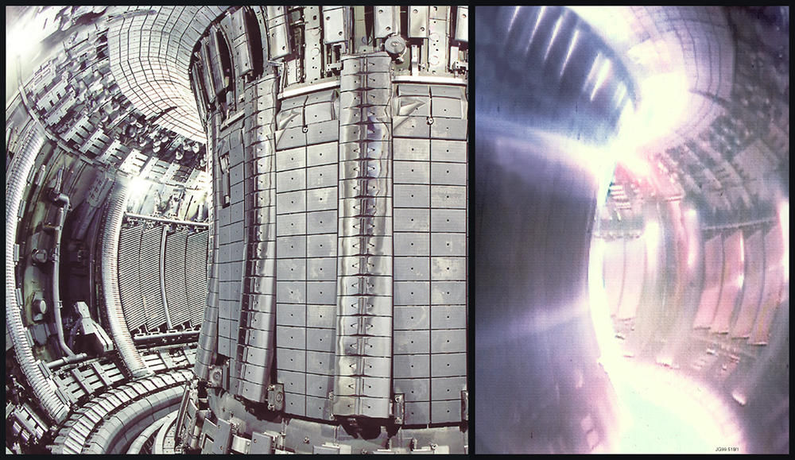
The JET tokamak

Slide 13

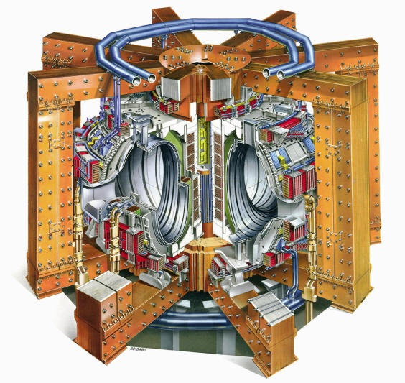







ITER - the Next Step
Produce significant amounts of fusion power (at least ten times the power required to heat the plasma up).
Plasma duration ~10 minutes
Aim at demonstrating steady-state operation.
Develop fusion reactor relevant technologies

Slide 14
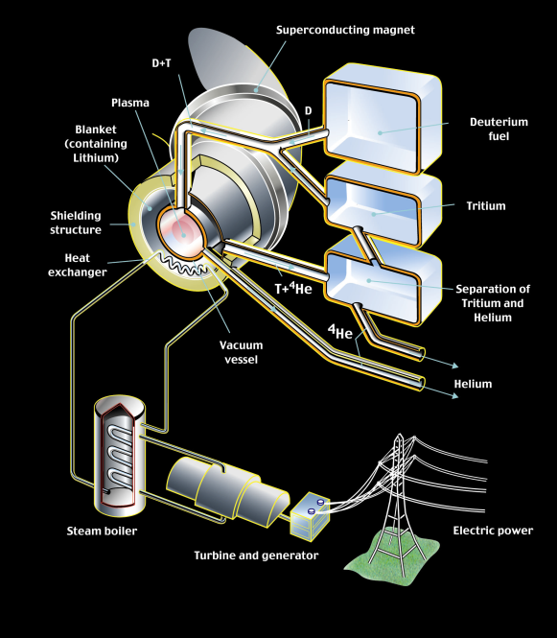
The future of fusion power
Fusion Power
Typical Plasma duration
When?
Gain
JET
1997 16MW 10 seconds 0.65
ITER
2020-2040 500-700MW 10 minutes 10
Power
Plant
2050? 1.5-2GW days/cont. 30

Slide 15
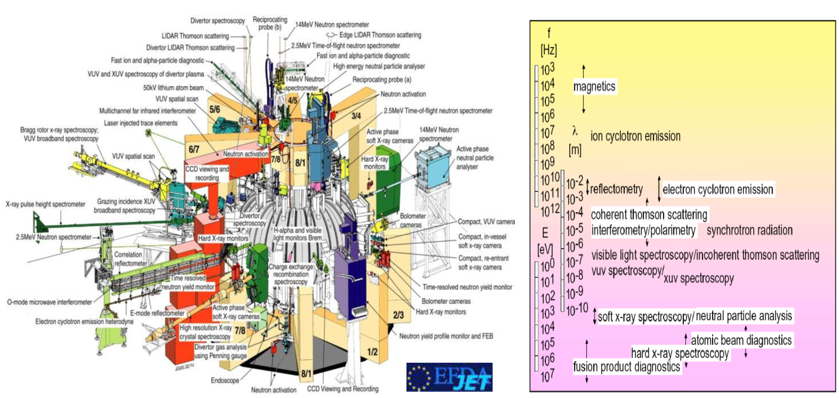
Diagnostics into Tokamaks – JET
Large tokamaks already make a number of measurements using a multitude of Diagnostics, in a wide frequency range, from very low frequencies (magnetics) to microwaves (CTS, reflectometry), visible (Thomson Scattering-LIDAR) and x-rays (spectroscopy)

Slide 16
ITER – making measurements
ITER will be an experimental device
As in all experiment, accurate measurements are essential
To control the plasma and to
protect the machine from damage
2. To allow advanced plasma
parameters to be controlled
3. To study the plasma physics
Plasma current
Plasma position & shape
Fusion power
e⁻ density
Material surface temperatures
Gas pressure
Impurity content
Toroidal magnetic field
Material erosion

Slide 17
ITER – making measurements
ITER will be an experimental device
As in all experiment, accurate measurements are essential
To control the plasma and to
Protect the machine from damage
2. To allow advanced plasma
parameters to be controlled
3. To study the plasma physics
n and α emission profiles
Current density profile
e⁻ temp and density profiles
Ion temp profile
Radiation power profile
MHD activity
Material surface power
deposition profiles

Slide 18
ITER – making measurements
ITER will be an experimental device
As in all experiment, accurate measurements are essential
To protect the machine from damage
To allow advanced plasma parameters to be controlled
To study the plasma physics
High frequency MHD
High resolution edge profiles
Density and temp fluctuations
Radial electric field
Plasma flows

Slide 19
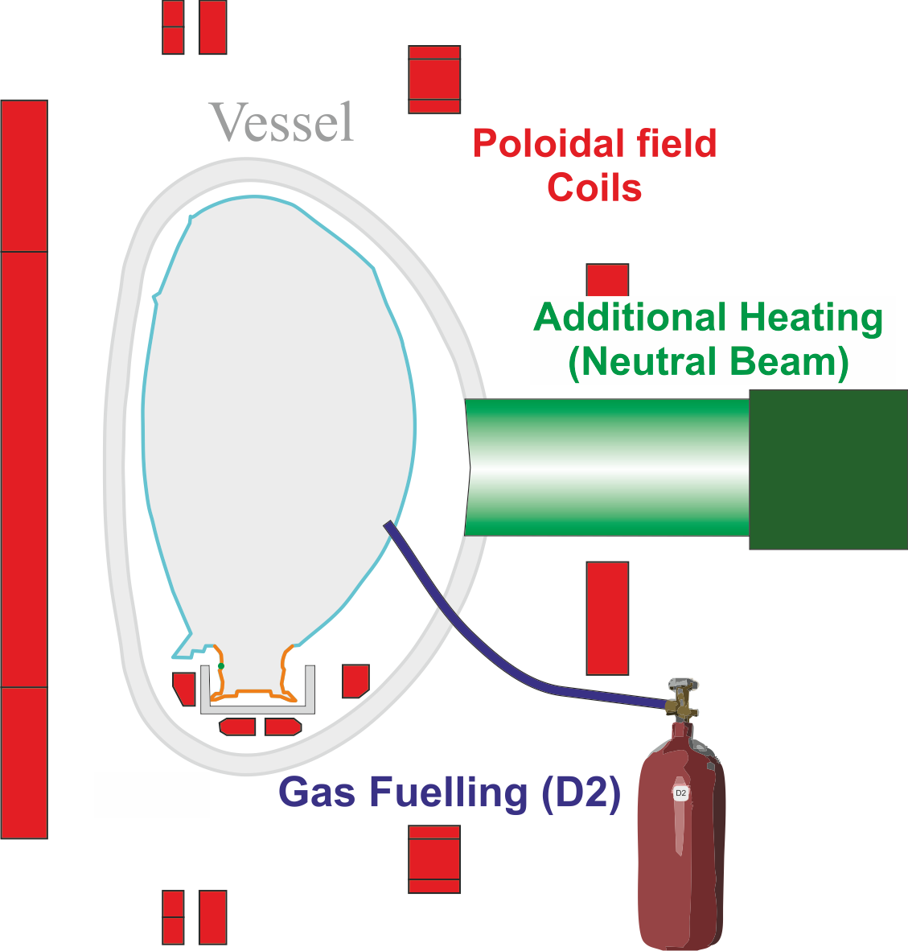
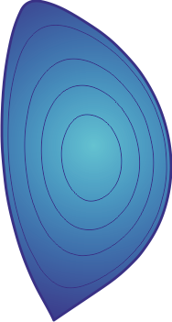
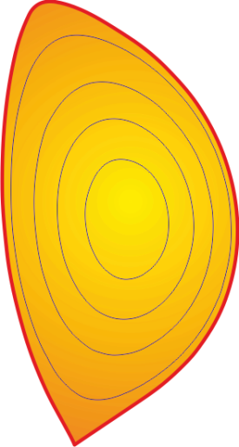
The plasma system
The Central solenoid creates an electric field.
GAS is added and ionised → plasma.
During plasma growth PF coils control plasma radial position.
Other PF coils shape the plasma into diverted shape
Additional heating heats the plasma
The conditions for fusion are reached!

Slide 20
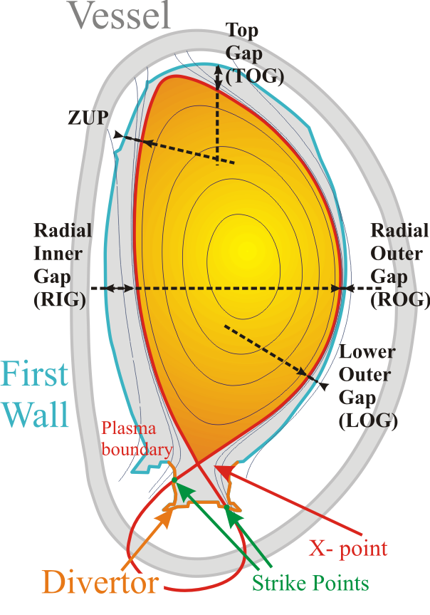
Shape control
Problem:
Plasma shape ➔ performance and interaction plasma-walls.
But: plasma pressure varies ➔ shape variation.
Actuator: PF Magnet System
Adjust PF currents ➔ shape corrected
JET: 9 PF coil currents
Diagnostic: Magnetic diagnostic System
+ Equilibrium Code
JET: circa 200 magnetic signals
Real Time Control System:
Calculates voltages to be applied to coils.
Complex: Time-variant, Non linear, Multi-Variable control problem.

Slide 21
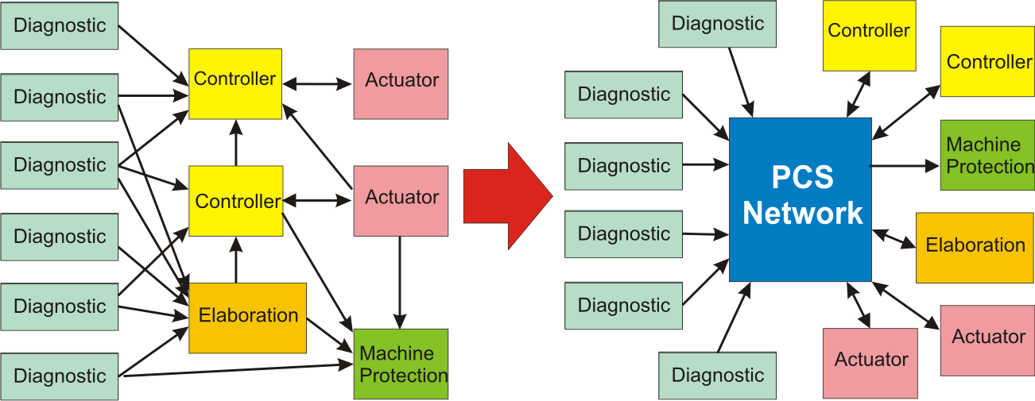
Plasma control system JET layout
Since a large number of Module outputs need to be shared a PCS network becomes necessary.
The network should allow efficient management of PCS, and at the same time satisfy the technical requirements. ➔

Slide 22
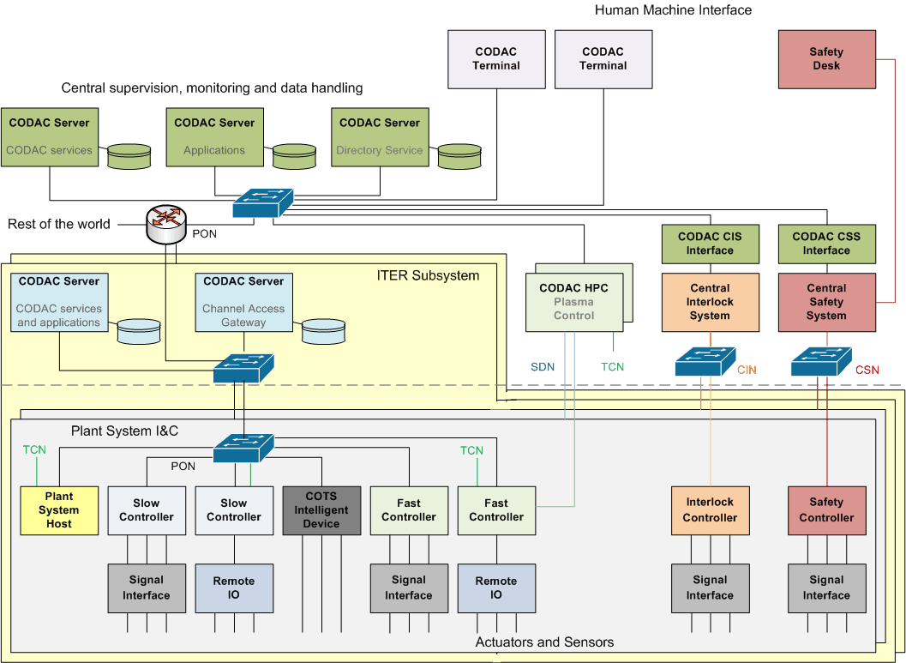
CODAC – interfacing between plant systems and central systems
Source: http://static.iter.org/codac/pcdh7/PCDH%20v7%20presentation.ppt

Slide 23
I&C standards - Physical interfaces: Networks
Plant Operation Network (PON): Industrial Ethernet
Synchronous Databus Network (SDN): UDP multicast on 10 Gb Ethernet
Time Communication Network (TCN): PTP, IEEE 1588
Audio-Video Network (AVN): 10 Gb Ethernet
Data Archiving Network (DAN): 10 Gb Ethernet
Central Interlock Network (CIN): Industrial Ethernet
Central Safety Network (CSN): Industrial Ethernet + Hard Wires
Source: http://static.iter.org/codac/pcdh7/PCDH%20v7%20presentation.ppt

Slide 24
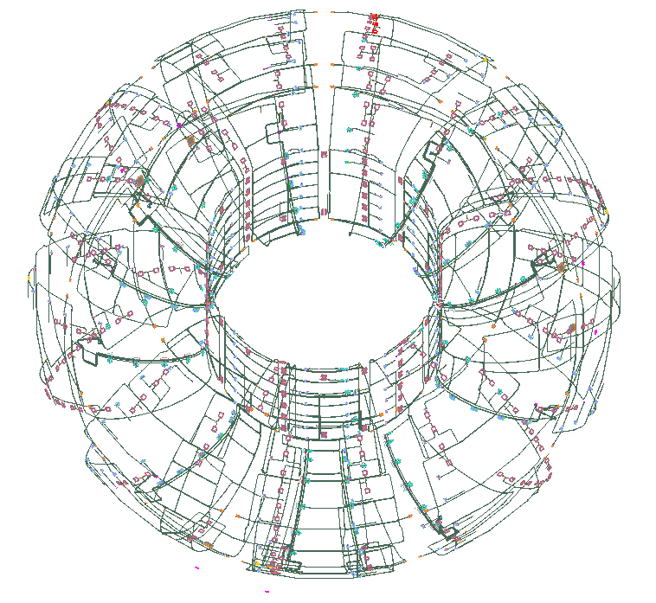
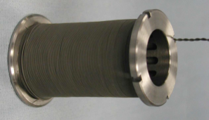
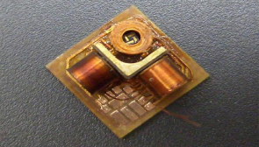
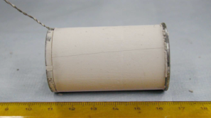
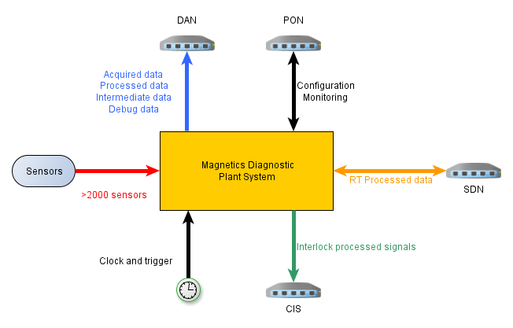

The magnetics diagnostic
Probes
Probes
Probes
Plasma control
Interlock
Physics
Shape
Current
Instabilities
Current
Energy
Magnetics Plant System
Diagnostic comprises
~1050 sensors inside the vessel (shown in figure)
~600 additional sensors outside vessel
Pick-up coils
Flux loops
Rogowski coils

Slide 25
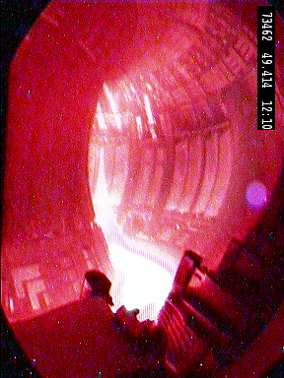

Magnetic measurements
Digital Integration
dB/dt
Conditioning
ADC
B
OR
Analogue Integration
dB/dt
Conditioning
B
ADC
dB/dt
Conditioning
ADC
dB/dt

Slide 26
From sensors to measurements
Linear combinations
Integrated measurements
Select
inputs
Coarse
Low latency
Matrix multiplications
Non-integrated measurements
Higher detail
Convergence
Complex algorithms
Start from a selection of probes
Integrated
Proportional
Different types of algorithmic strategies
Fast and robust
Slower and precise
Depending on the context
Control
Protection
Physics
Data from other diagnostics
Same measurement might be used in different contexts
…and consequently calculated with different methods

Slide 27
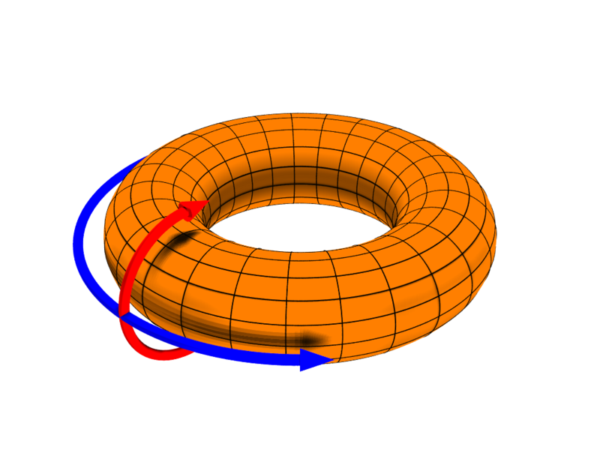
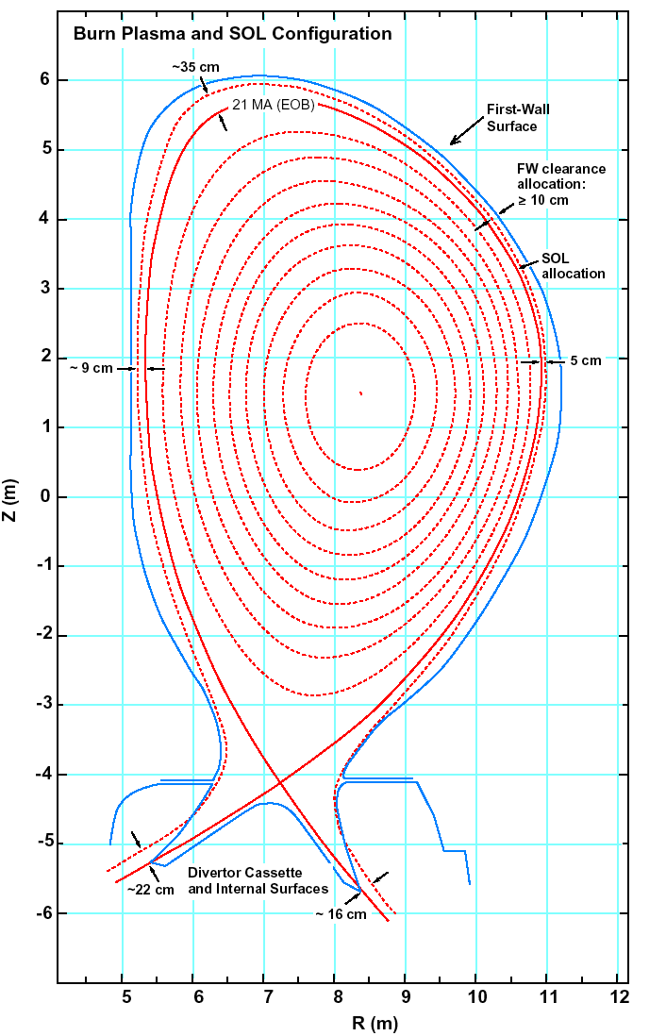
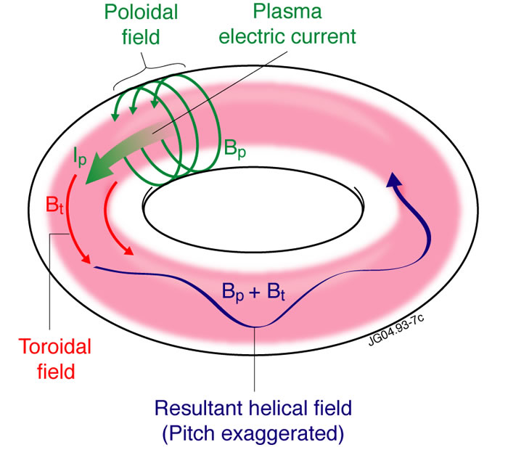
Typical coordinates
Toroidal direction
Poloidal direction

Slide 28
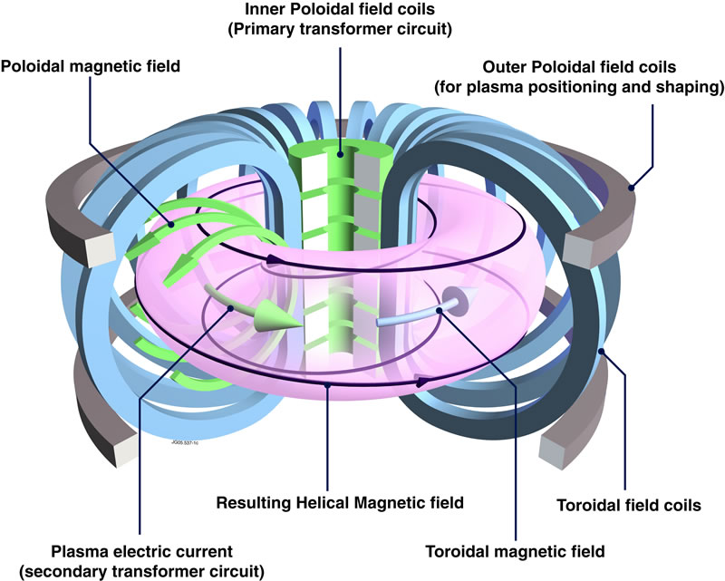
Axisymmetric plasma
For a large number of real-time control measurements
Plasma can be considered axisymmetric
i.e. control parameters (e.g. shape) do not depend on the toroidal angle
Coils in same poloidal position, but different toroidal angle have redundant information!

Slide 29
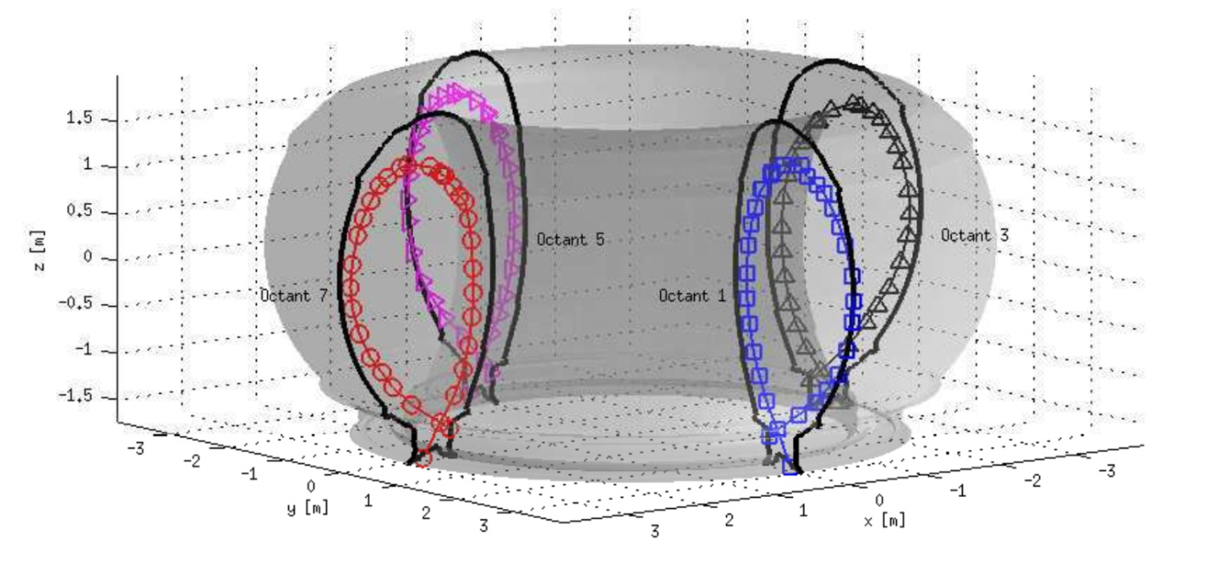

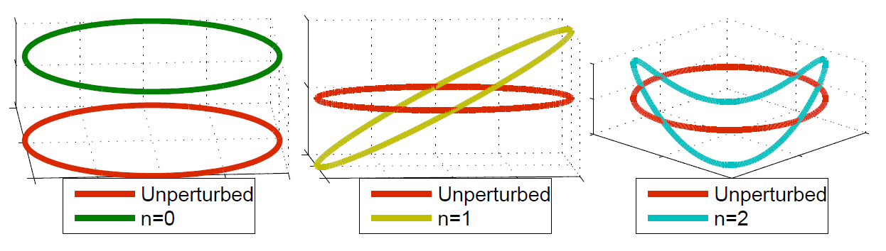
Toroidal modes (no axisymmetry!)
Magnetohydrodynamics (MHD)
Toroidal asymmetries
That rotate with plasma
Coils in same poloidal position, but different toroidal angle will have different information!
Might lead to unstable control!
Immunity to modes requires the availability of coils in same poloidal position, but different toroidal angle
Less redundancy!

Slide 30
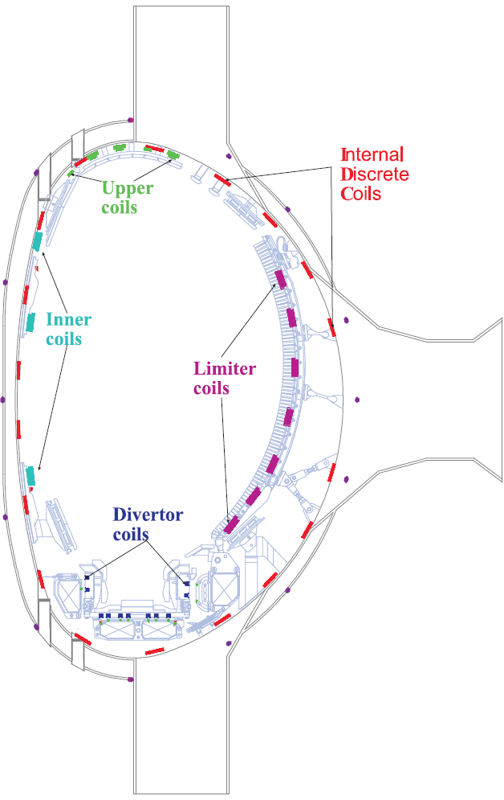
Poloidal redundancy
If enough measurements are available
It is possible to infer on the value of a given probe
This can be used to replace a faulty sensor with a virtual measurement
Without requiring reconfiguring algorithms that use the faulty probe
x
Use measurements from other probes to generate virtual probe
Measurement lost!

Slide 31
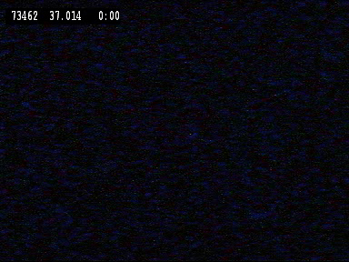
Why are redundancy and availability so important?

Slide 32
Magnetics diagnostic activities
Design
Prototyping
Design reviews support
Plant Controller
Prototype
Design
Design reviews
System architecture
Embedded
Real-time
System architecture
CODAC Interfaces
CODAC Interfaces
Networks
Calculations
Software
Documentation
Scientific
Custom hardware
Custom hardware

Slide 33
Magnetics diagnostic activities: plant architecture
Design
Prototyping
Design reviews support
Plant Controller
Prototype
Design
Design reviews
System architecture
Embedded
Real-time
System architecture
CODAC Interfaces
CODAC Interfaces
Networks
Calculations
Software
Documentation
Scientific
Custom hardware
Custom hardware

Slide 34
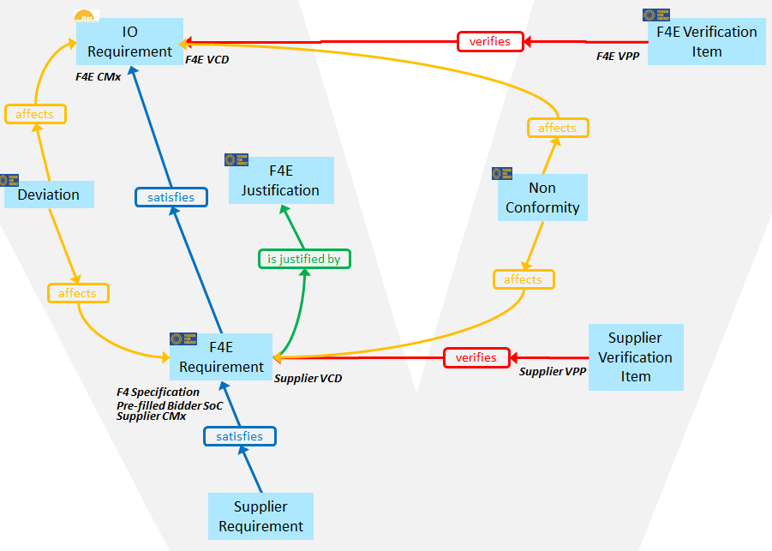
Formal design - Requirements
IBM - Rational DOORS to manage requirements
We use it to manage all the diagnostic I&C requirements
F4E RMV team offers a powerful data model
Tool
(useful)
Requirements

Slide 35
Formal design - SysML
Sparx Systems – Enterprise Architect
From I&C requirements to system architecture
SysML formal design

Slide 36
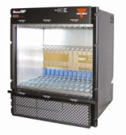
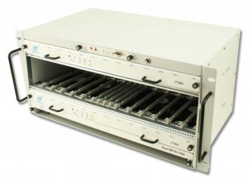
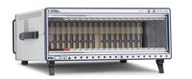
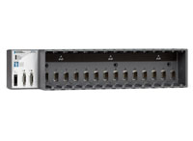
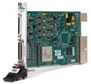



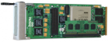
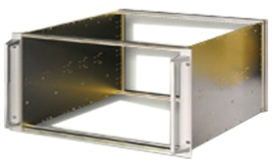
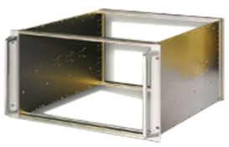
Physical architecture of the system
ATCA
uTCA
PXI/PXIe
cRIO
FPGA prototyping boards
Signal processing
Signal interface
This requires prototyping state-of-the-art solutions
Some times these are obtained as a sub-product of large scientific projects

Slide 37
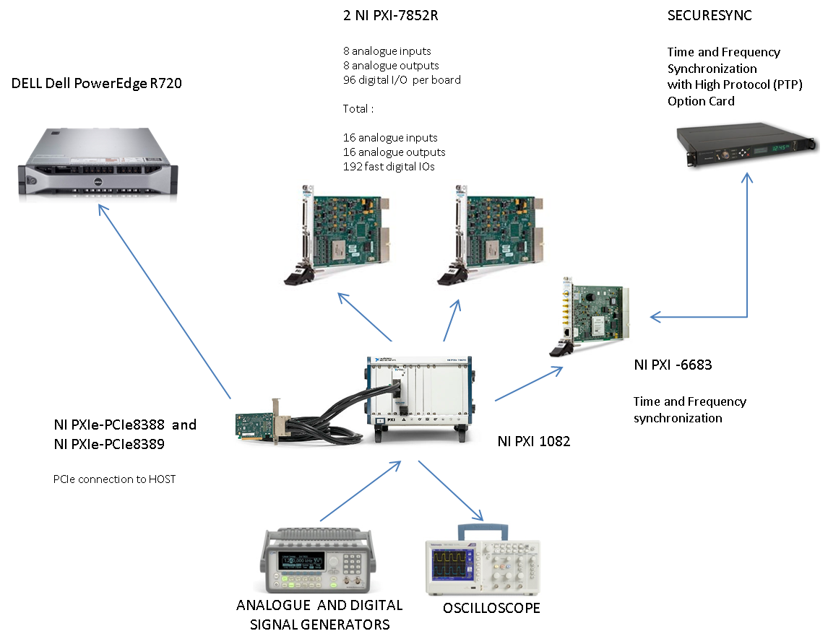
Some prototyping activities under our current scope
Investigate general fast hardware solutions that can be reused in future F4E projects
Survey
Upgradability , manufacturability, scalability
Availability and reliability
Channel density
Test rig
Based in COTS solutions
Test plans and test reports

Slide 38

PIMPA???
The way signals are distributed and connected has an effect on the reliability of the system parameters
Objective: Minimise the effect that the failure of a given probe or electrical has on the computation of any given parameter
i.e. increase the reliability of the system
Switches
Eth links
PFSC
&
PIS controllers
uTCA chassis
Fast serial links
Solution: oPtImal Measurement Probes Allocation (PIMPA) tool
Custom chassis

Slide 39
Magnetics diagnostic activities
Design
Prototyping
Design reviews support
Plant Controller
Prototype
Design
Design reviews
System architecture
Embedded
Real-time
System architecture
CODAC Interfaces
CODAC Interfaces
Networks
Calculations
Software
Documentation
Scientific
Custom hardware
Custom hardware

Slide 40
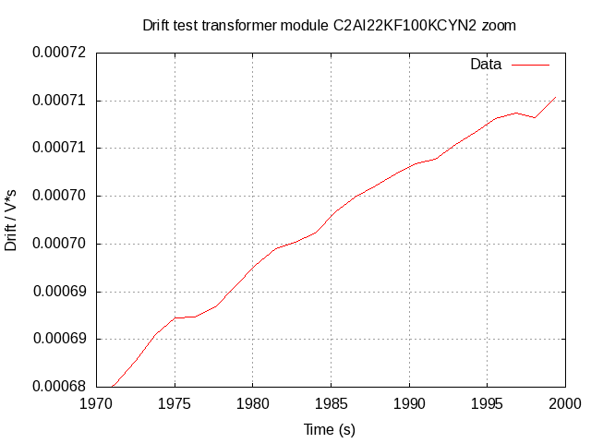
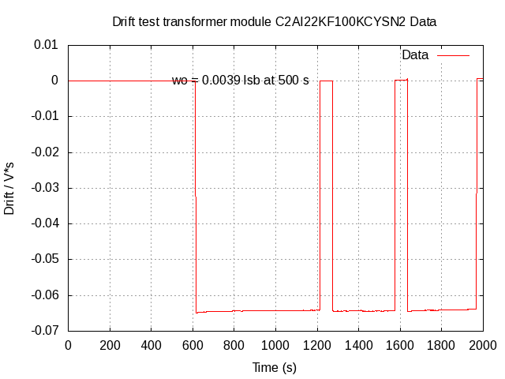
Magnetics integrator
One of the most challenging requirements of the diagnostic
dB/dt
Conditioning
B
Current integrators work for a limited amount of time
The uncompensated integral drift drives the measurement error to unacceptable values
But if we look carefully and zoom at the end…
Looks perfect…
On ITER the measurement error is very stringent…
Solution proposed by A. Werner and prototyped by Portuguese team could address the issue

Slide 41
Magnetics integrator tests
(1 of many the tests)

Slide 42
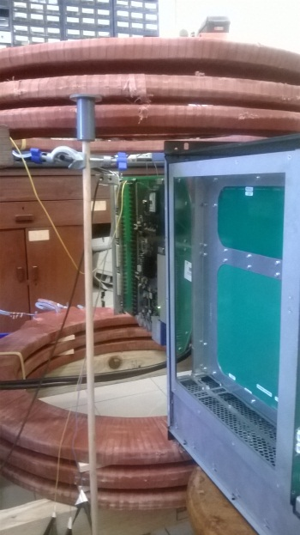
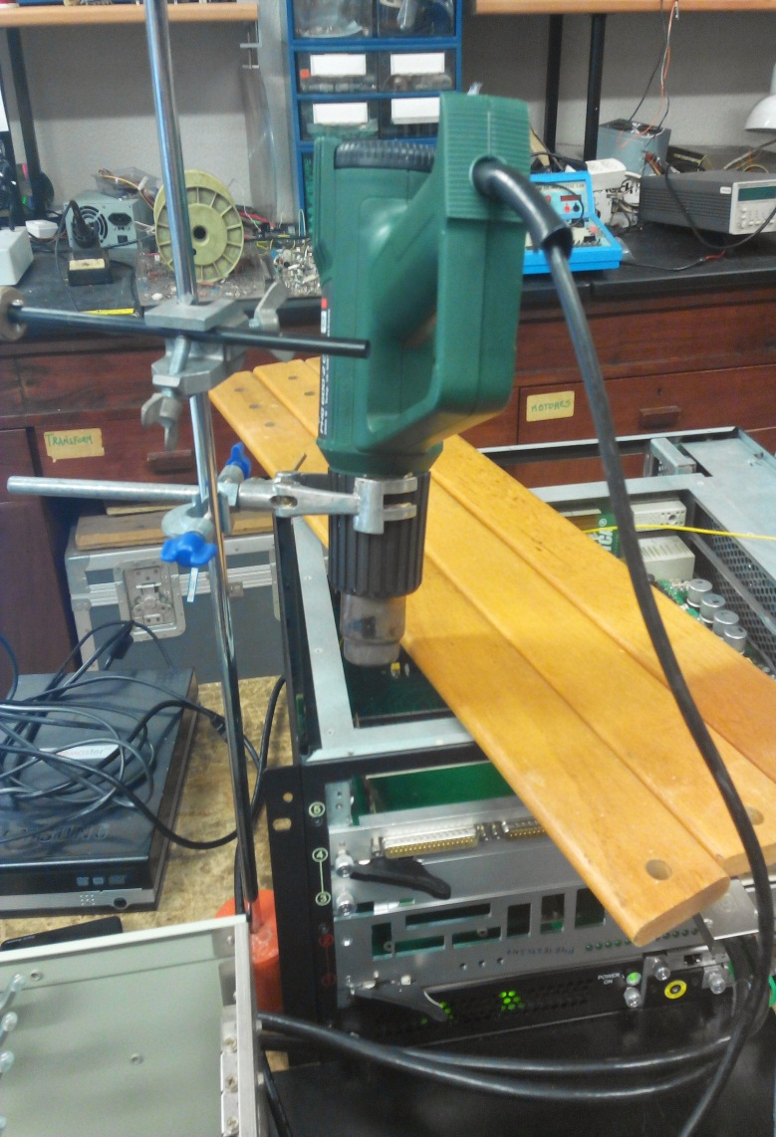
Magnetics integrator tests
(2 of many examples)
Disturbance from external magnetic fields
Effect of temperature

Slide 43
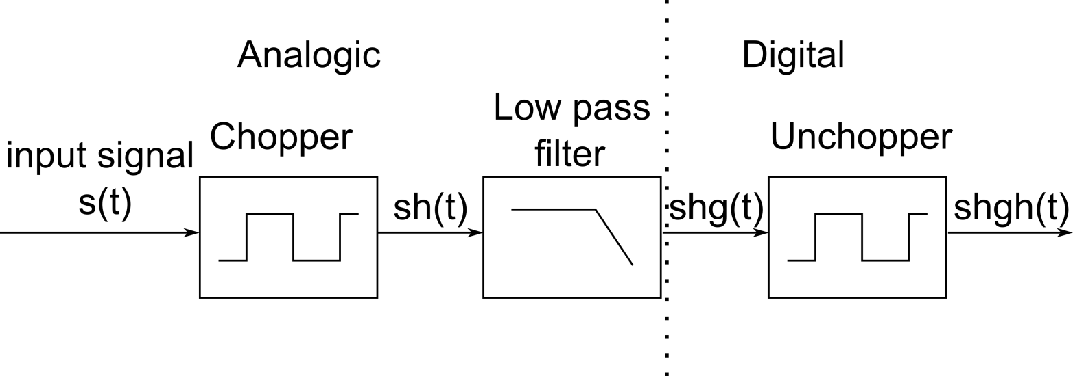

Use theory to try to understand the results
f_{s} = input signal frequency
f_{c} = chopper frequency
n and k odd (harmonics of chopper and unchopper square waveforms)
If f_{s}= (n+k) f_{c} for some particular n and k→ some energy will be transferred to the 0 component => drift change…

Slide 44



Use theory to try to understand the results
Before demodulation
After demodulation
10x600-5x1000=1000 => DC after demodulation
600 Hz input signal with harmonics.
1 kHz chopping frequency.
m indicates the harmonic of the input signal.
n indicates the harmonic of the chopper.

Slide 45
Magnetics diagnostic activities
Design
Prototyping
Design reviews support
Plant Controller
Prototype
Design
Design reviews
System architecture
Embedded
Real-time
System architecture
CODAC Interfaces
CODAC Interfaces
Networks
Calculations
Software
Documentation
Scientific
Custom hardware
Custom hardware

Slide 46





MARTe?
Multi-platform C++ real-time control middleware
  Simulink-like way of describing the problem
Modular development and execution environment for control systems
Ensures and monitors real-time
Facilitates test & commissioning

Slide 47

Main features
Modular
Clear boundary between algorithms, hardware interaction and system configuration
Reusability and maintainability
Simulation
Agnostic of the operational environment
  Different profiles of people can develop in parallel
    Interfaces to hardware
    Algorithms
    Interfaces to CODAC
  Develop and test in different platforms
    Deploy the same source

Slide 48




Modularity (GAMs)
Define boundaries
  Algorithms and hardware don't mix!
  Modules do only what they advertise
  No interdependence or a priori knowledge
Generic by design
  Same goals, same module
  Reusability and maintainability
Simulation
  Replace actuators and plants with models
  Keep all the other modules untouched
Hardware
Models
Persistence
Algorithms
Debug
Decision
Scheduling
Information

Slide 49

Real-time threads
Sequentially execute GAMs
  Work as micro-schedulers
  Can be allocated to specific CPUs
Keep accurate information about execution times
Require an external time and triggering mechanism
Multiple RTThreads can run in parallel
  Synchronously or asynchronously

Slide 50
Where is MARTe being used
JET (UK)
Vertical Stability (50 us)
COMPASS (CZ)
Shape control (500 us)
Real-time Protection Sequencer (2 ms)
Vessel Thermal map (10 ms)
Equinox (2 ms)
Walls (10 ms)
Beta-Li (10 ms)
As part of post-processing codes (variable)
Vertical Stability (50 us)
ISTTOK (PT)
Integrated plasma control (100 us)
FTU (IT)
Integrated plasma control (500 us)
Additional heating control
KSTAR (KO)
*Density control
RFX (IT)
Performance studies of the framework (125 us)

Slide 51
Magnetics diagnostic activities
Design
Prototyping
Design reviews support
Plant Controller
Prototype
Design
Design reviews
System architecture
Embedded
Real-time
System architecture
CODAC Interfaces
CODAC Interfaces
Networks
Calculations
Software
Documentation
Scientific
Custom hardware
Custom hardware

Slide 52
Design diagnostic algorithms
Based on plasma electromagnetic simulations
Study different operational scenarios
Optimise and select the best location to locate the sensors
Estimate the electronics requirements
Resolution
Admissible errors
Maximum voltages (including extreme and fault conditions)
Design the software algorithms
To estimate the quantities that have to be controlled
Shape
Position
Instabilities
To study physics
…

Slide 53
Overview…
Design involves disparate set of activities
  Critical diagnostic for the operation of the machine
Industrial (Aerospace sector like)
  I&C integration
  Methodologies and Q&A
  Critical software development
Academic
  Fusion know-how
  R&D
Many Suppliers involved
  CREATE (UNINA-IT)
  IST (PT)
  CCFE (UK)
  INDRA (ES)
  GTD (ES)

Slide 54





Thank you for your attention
Follow us on:
www.f4e.europa.eu
www.twitter.com/fusionforenergy
www.youtube.com/fusionforenergy
www.linkedin.com/company/fusion-for-energy www.flickr.com/photos/fusionforenergy

