Slide 1
Qualitative methods in data gathering
Prof. Flora Amato

Slide 2
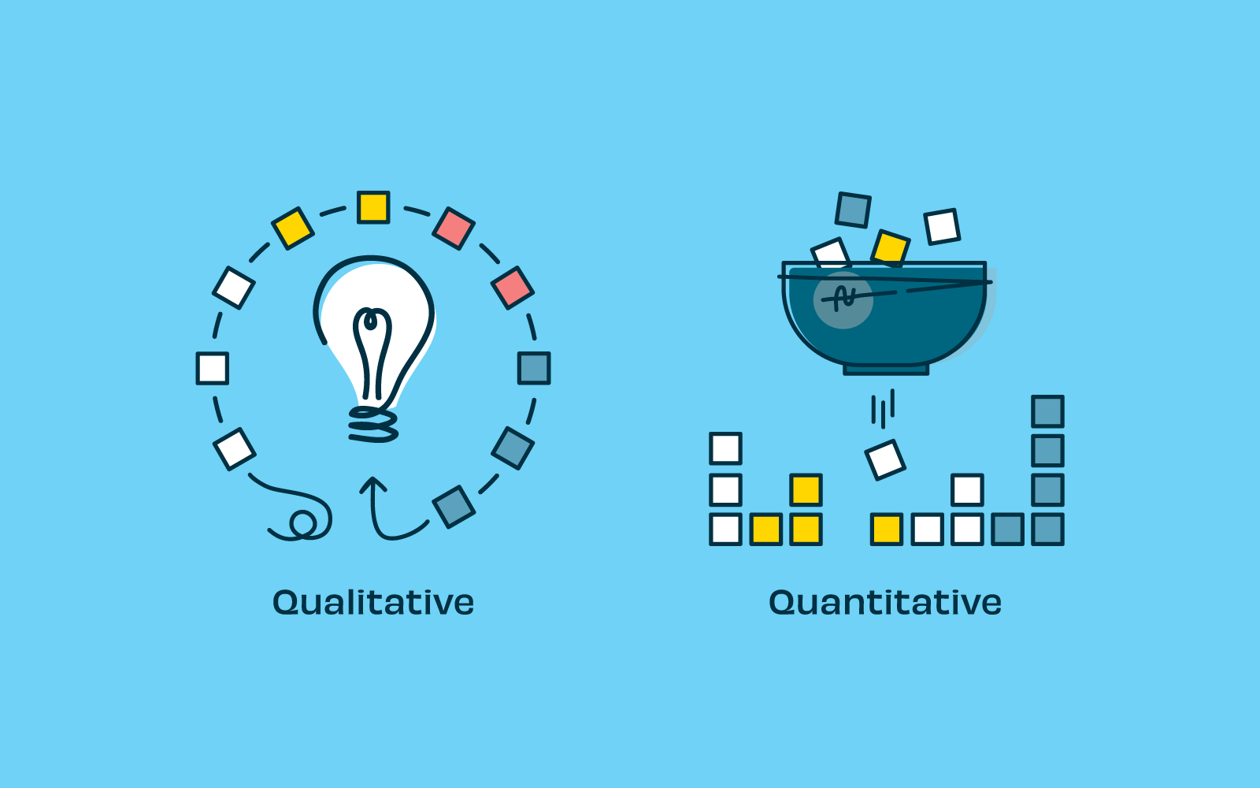
Data Gathering Methods
Source: A beginner’s guide to qualitative and quantitative research - Optimal Workshop
Notes:
Tot ongeveer 10:00

Slide 3
Qualitative Methods
Source: THE NOT-SO-OBVIOUS BENEFITS OF QUALITATIVE RESEARCH
Notes:
Tot ongeveer 10:00

Slide 4
Quantify the Qualitative Methods
How many Qualitative Data Gathering Methods do You Know?
Source: Microsoft Images Online Library

Slide 5
What is the Process of Qualitative Data Collection
Observe the main steps
Source: Microsoft Images Online Library

Slide 6
Participants and Sites
Have You identified the
Participants and Sites?
Source: Microsoft Images Online Library

Slide 7
Data Access
How you gain access
to the Data?
Concerns about Permissions
Questa foto di Autore sconosciuto è concesso in licenza da CC BY-SA

Slide 8
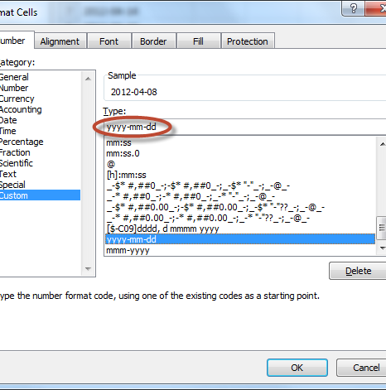
Data Type
Have you defined the data type to collect?
Questa foto di Autore sconosciuto è concesso in licenza da CC BY-SA

Slide 9
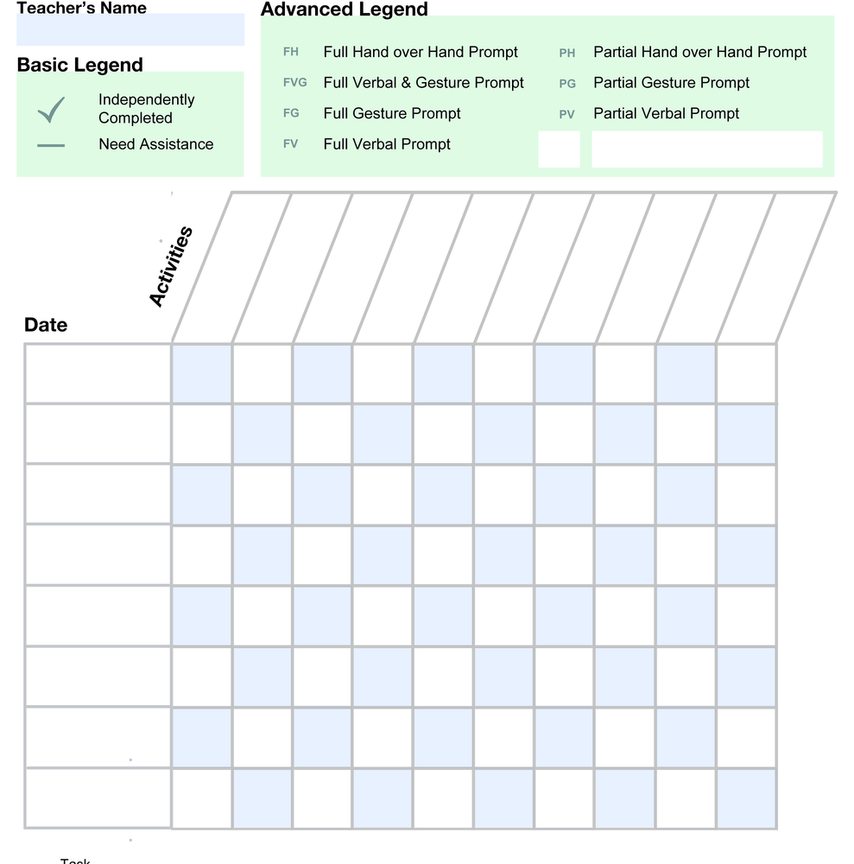
Data Collection Form
Have You developed data collection forms?
Questa foto di Autore sconosciuto è concesso in licenza da CC BY-NC-ND

Slide 10
Ethical Concerns
Have You Administrate the process in the Ethical Manner?
Source: https://rjanecagatiniobrohade.wordpress.com/2015/01/30/ethics/

Slide 11
Reviewing resources: are good for You?

Slide 12
Assignment:
Divide the Class in two groups
Each group should define, design and prepare a Data Collection Plan for collecting data about wellness level of the other groups
Discuss About
Privacy Concerns
Ethical Concerns
Technical Concerns..

Slide 13
References
A beginner’s guide to qualitative and quantitative research - Optimal Workshop. David Renwick. https://blog.optimalworkshop.com/a-beginners-guide-to-qualitative-and-quantitative-research/
Qualitative data collection. Susheewa Mulmuang.
THE NOT-SO-OBVIOUS BENEFITS OF QUALITATIVE RESEARCH. The Not-So-Obvious Benefits of Qualitative Research (klcommunications.com)
https://bibliotheek.hu.nl/hulp-en-ondersteuning/bronvermelding/

Slide 14
Questions?
Thank You!

